Slide 1
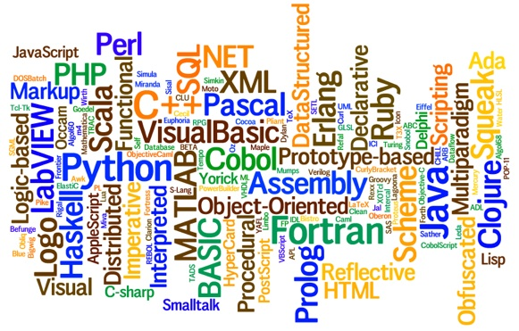
CS445 Programming Languages Lecture 4 – PL Paradigms
By Talha Waheed, UET Lahore

Slide 2
Course Learning Objectives

Slide 3
Programming Language Paradigms
various ways to categorize or classify languages. often related to programming styles (techniques, paradigms)
languages SUPPORT (not require) style or paradigm
you can write "objects" in C
you make C++ look like Fortran
you can write "functional Java"

Slide 4
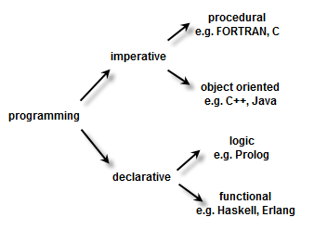
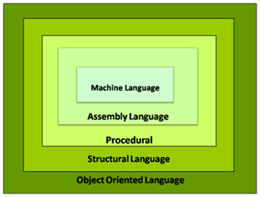
Programming Language Paradigms

Slide 5
Major Programming Language Paradigms
Imperative (or Procedural)
variables, assignment, iteration
Object Oriented
close relatives of imperative
Functional (applicative)
set of functions, “no variables”, no assignment, no iteration
Logic (Declarative)
rule based
Order of execution in not defined

Slide 6
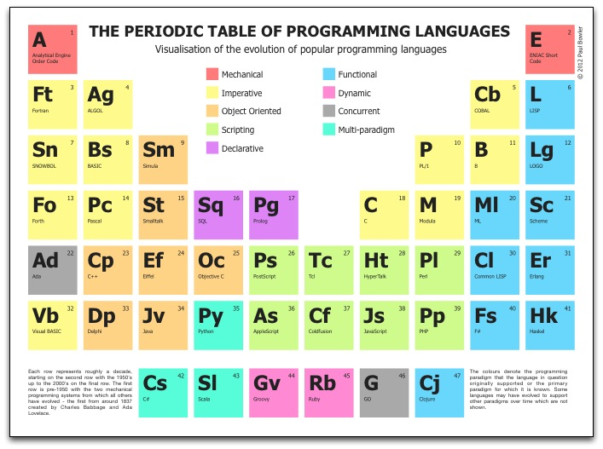

Slide 7
Language Paradigms ­ Imperative (Procedural) Programming 1/2
Fortran, Algol, Pascal, C, COBOL, BASIC, Ada, Modula...
influence: machine architecture, Based on van Neumann's view
model: moving bits around, changing machine state
Program changes the contents of memory (state) in some way.
A program is a sequence of commands to the machine.
Syntax: Stmt1, Stmt2, Stmt3, ...
Action oriented: each command tells the computer to perform an action.
Key actions/operations: assignment, iteration, selection.

Slide 8
Language Paradigms ­ Imperative (Procedural) Programming 2/2
Goal is to understand a machine state (set of memory locations, each containing a value)
Statement oriented languages that change machine state e.g. for the following formula of factorial
(N! = N * (N-1) * (N-2) *… * 1)
The imperative code is
Factorial = 1
For Index = 2 to N
Factorial = Factorial * index (state of factorial changes with each iteration)

Slide 9
Common Ideas
Modern imperative languages (Ada, C++, Java) have similar characteristics:
large number of features (grammar with several hundred productions, 500 page reference manuals…)
a rich type system
procedural mechanisms
object-oriented facilities
abstraction mechanisms, with information hiding
several storage-allocation mechanisms
facilities for concurrent programming (not C++)
facilities for generic programming (not Java)

Slide 10
Language Paradigms -­ Object-Oriented 1/2
Started with Simula (language for simulation) b/w 1961-­67.
Currently: Smalltalk, C++, Java, Eiffel, Objective-C
Key concepts: classes and subclasses, inheritance.
Key operation: message passing.
Influence: simulation, real world modeling, games
Improved form of language extension (add new data types, ADT)
Model: message-passing, interacting objects (properties, behaviors)
A program describes the behaviors supported by its objects,
a fraction can be simplified by the communication between these objects. e.g., ``Fraction f1, simplify yourself.''

Slide 11
Language Paradigms -­ Object-Oriented 2/2
Syntax: Set of objects (classes) containing data (imperative concepts) and methods (applicative/functional concepts)
Object oriented languages are typically imperative (e.g. C++, Java), but can also be functional (e.g. CLOS-Common Lisp Object System).
Some Imperative languages that merge applicative design with imperative statements (e.g. Java, C++, Smalltalk)

Slide 12
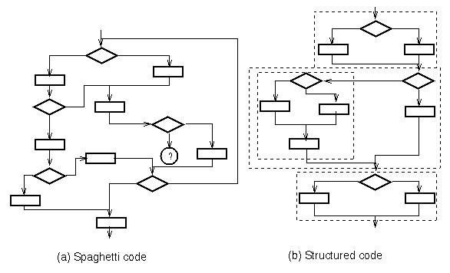
Applicative Techniques in Imperative Languages

Slide 13
Language Paradigms ­ Functional (Applicative) Programming 1/2
Started with Lisp (LISt Processor) (1958). Currently: Lisp, Scheme, ML, Miranda, Haskell. Sisal, Haskell, APL
influence: mathematics, lambda calculus
model: function or operator evaluation (application)
A program is based on the recursive definition of functions.
Each function and whole program is mathematical function of inputs. E.g. “The reverse of a list is the last element followed by the reverse of the rest of the list (or is empty if the list is empty).''
No internal state - no side effects.
Key operation: expression evaluation.
Syntax : P1(P2(P3(X))) – nested function calls

Slide 14
Language Paradigms ­ Functional (Applicative) Programming 2/2
Goal: to understand the function that produces the answer
Function composition is major operation (in ML, LISP)
Programming consists of building the composition of functions that computes the answer
E.g.
Factorial (integer N)
If (N=1)
return (1) (base case)
Factorial(N-1)*(N) (recursive call of factorial)

Slide 15
Language Paradigms ­- Logic Programming (Rule based) 1/2
Prolog -­ PROgramming in LOGic (1972).
Many names: rule-based, declarative, production/constraint systems
influence: logic, predicate calculus
model: proof, deduction / matching, backtracking
Programs consist of facts, rules and queries.
Programs don't say how to find a solution.
“What can be inferred from the program?”
Key operation: “Unification”.
forward or backward chaining of condition-action rules
Notes:
Specify rule that specifies problem solution (Prolog, BNF Parsing)
Other examples: Decision procedures, Grammar rules (BNF)
Syntax: Answer → specification rule
Programming consists of specifying the attributes of the answer

Slide 16
Language Paradigms ­- Logic Programming (Rule based) 2/2
Rule 1: Factorial(N, N) is true if N is 1 or 2 (Base Case)
Rule 2: Factorial(N, R) is true if there exist A and B such that all of the following are true Factorial(A, B) is true, (Recursive Case)
A= N - 1,
B = R/N
Query: What values of R make Factorial(3, R) true?

Slide 17
Logic Programming (Example)
Facts:
Ann is an elephant.
Ann has a long trunk.
Ann has big ears.
Ann is an animal.
Rules:
If X is an animal and X has big ears and
If X has a long trunk, then X is an elephant.
Queries:
Who is an elephant? Is Marc an elephant?

Slide 18
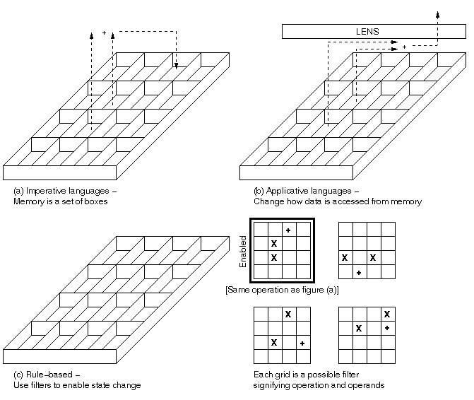
Computational models of programming languages

